Slide 1
Mapping
JOUR479D/779D
University of Maryland
Nick Diakopoulos

Slide 2
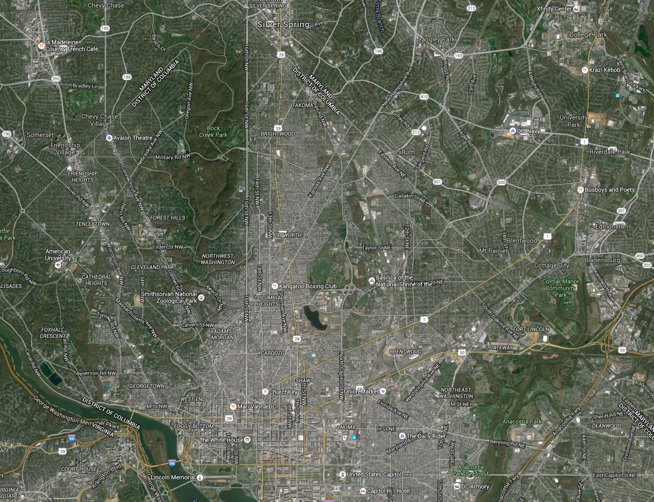
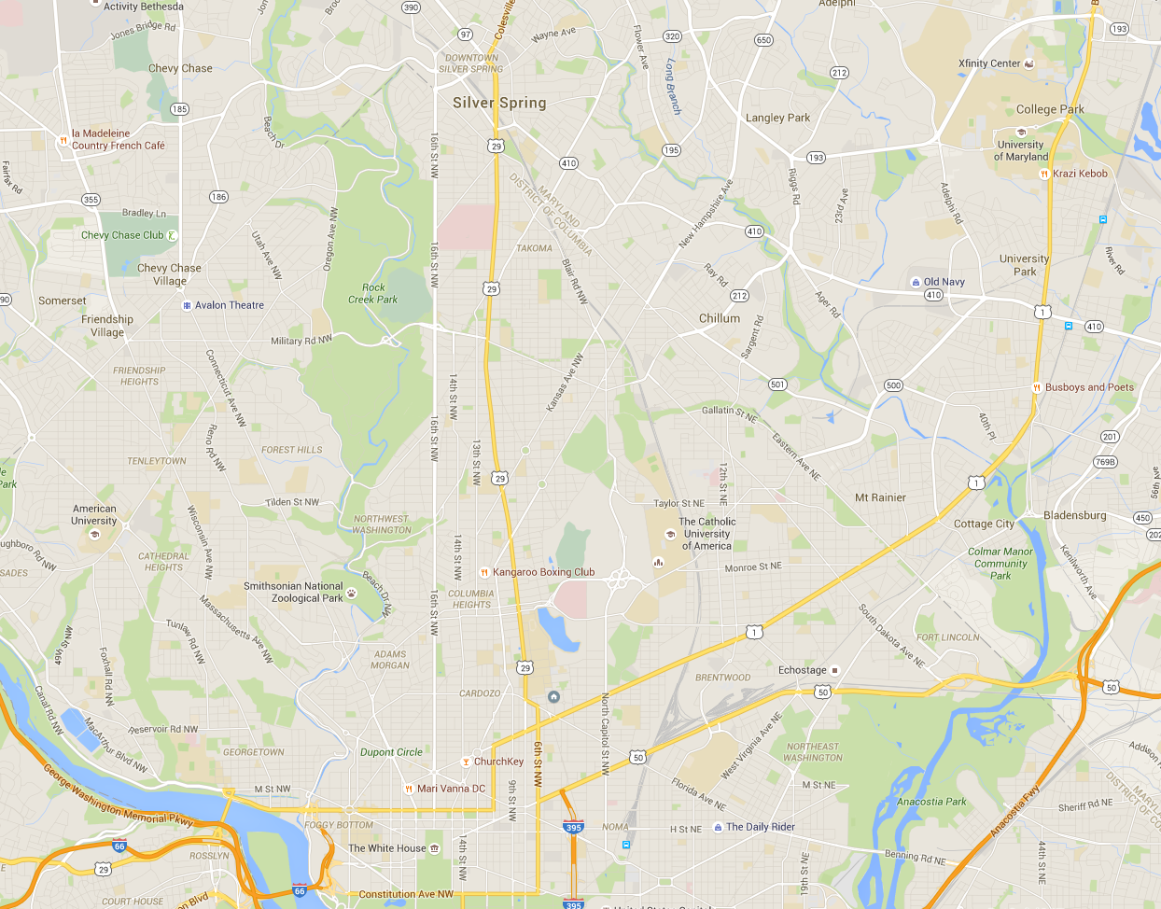
Notes:
Image of google maps which shows both types of map data – raster images showing land cover, and vector and point data showing locations of roads and services.

Slide 3
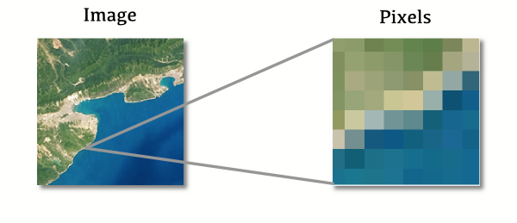
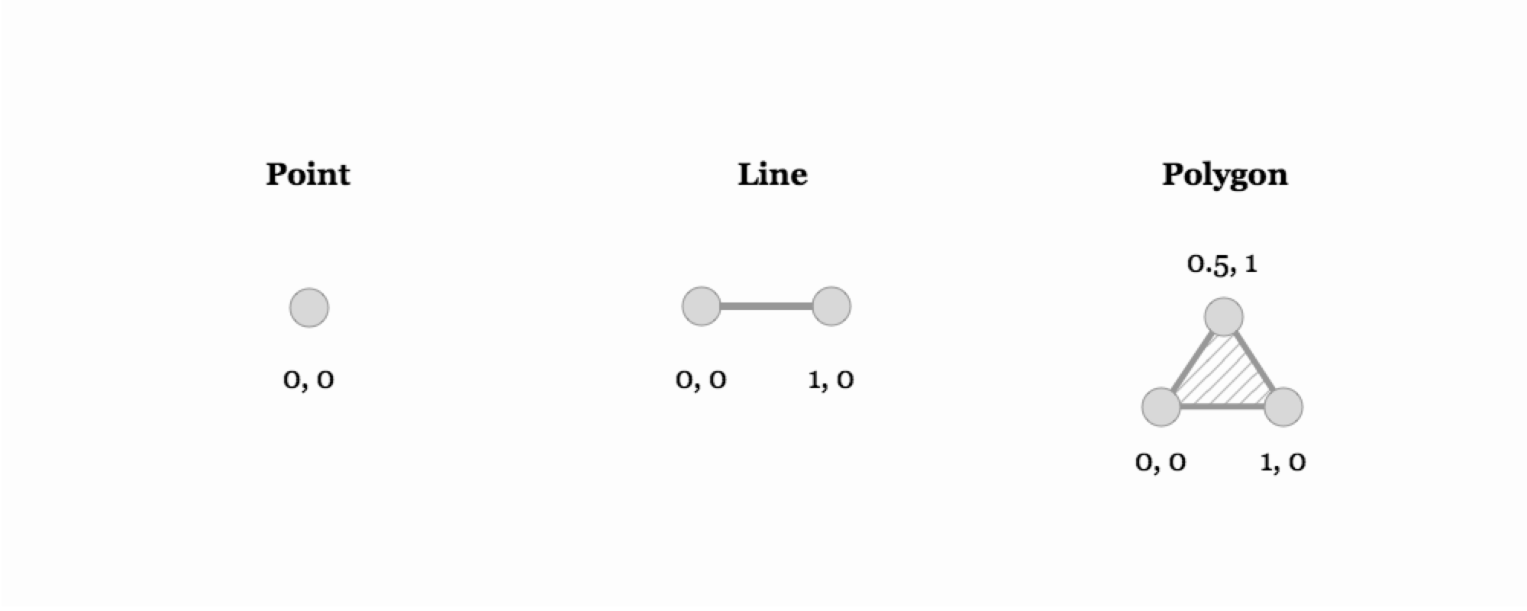
Raster vs. Vector
Notes:
First some ground rules about mapping. Map data comes in two varieties and you can see both when you toggle back and forth on Google maps.

Slide 4
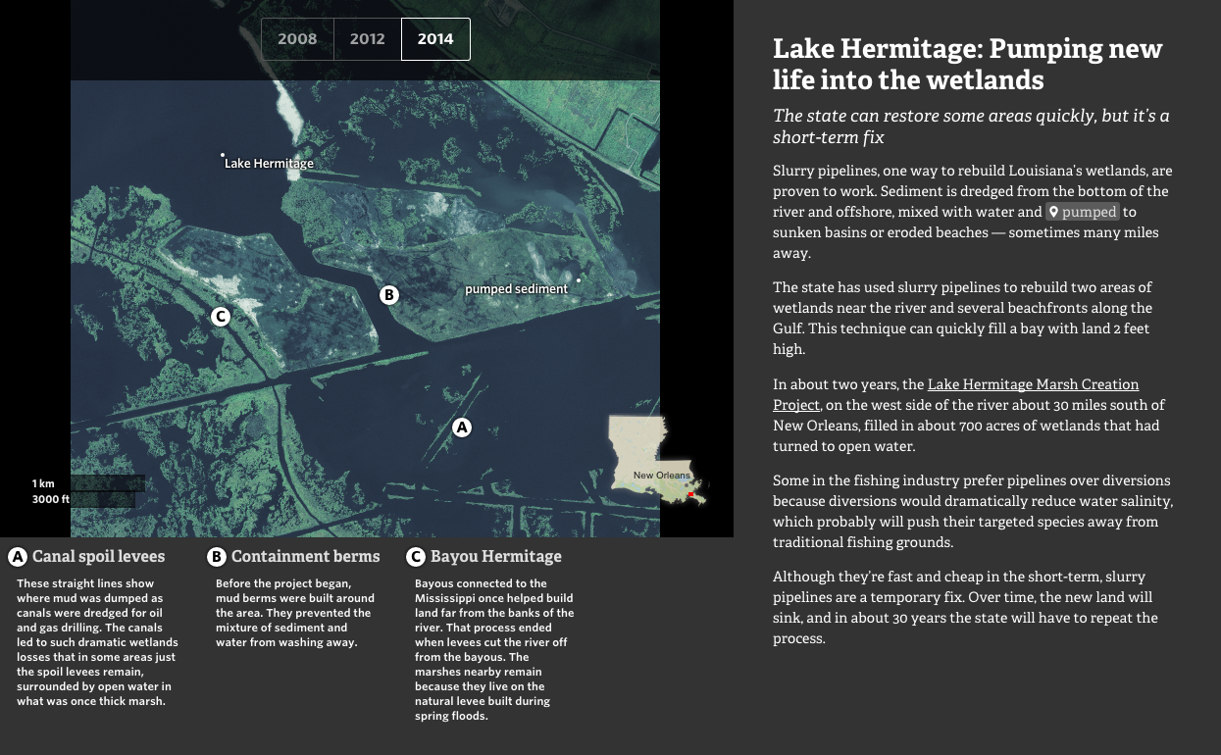
http://projects.propublica.org/larestoration
Notes:
Example of effective integration of two types of map data.
Also: of note is the “Locator” map in the lower right, which provides larger geographic context for the larger map.
What I like about this piece is how they really effectively use comparisons to show how the land is evolving.

Slide 5

http://mapknitter.org/
Notes:
To get some of that aerial footage they also relied on techniques for balloon and kite imaging. Such rigs can be useful for getting very high res imagers and to do so for breaking news (satellites not fast enough), OR to get aerial imagery of something contentious like a factory that might be leaching pollutants.
Mapknitter.org is a tool that can be used to rectify and stitch together such imagery.

Slide 6
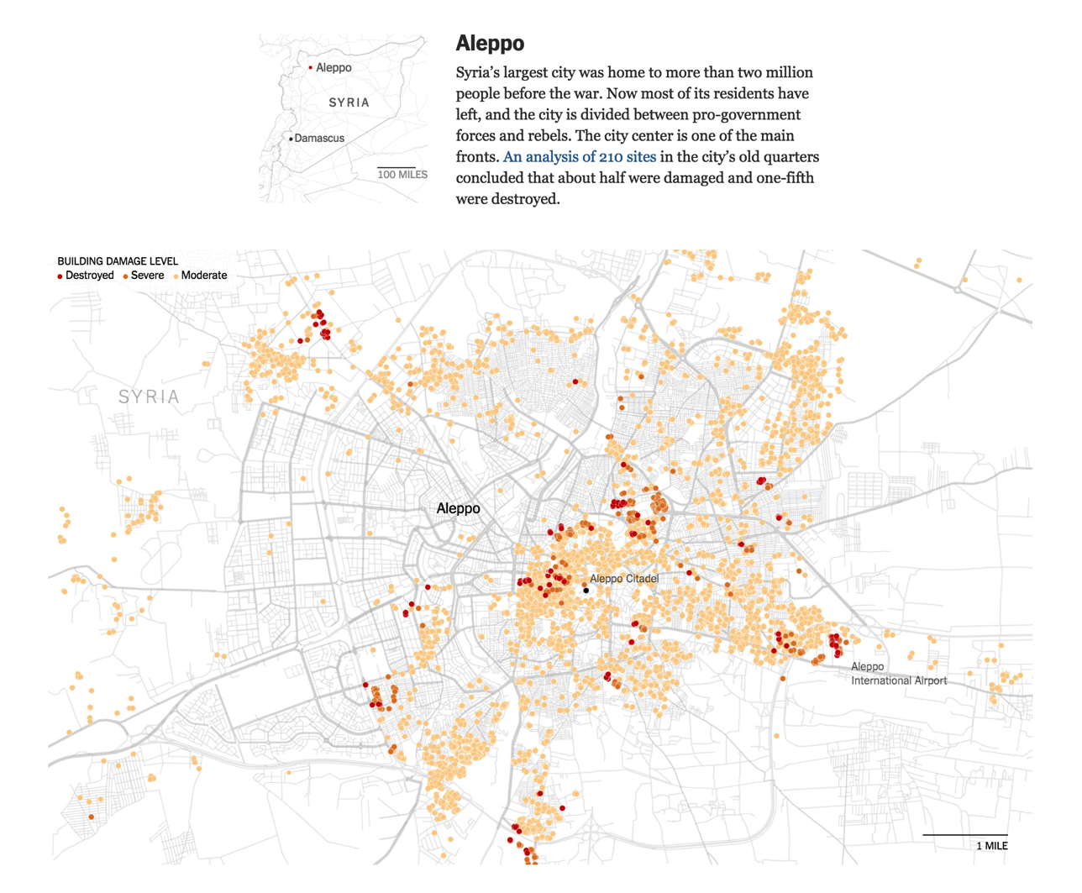
http://www.nytimes.com/interactive/2015/02/12/world/middleeast/syria-civil-war-damage-maps.html?_r=0
Notes:
Locator maps help create a spatial context for the reader. Here’s another example.

Slide 7
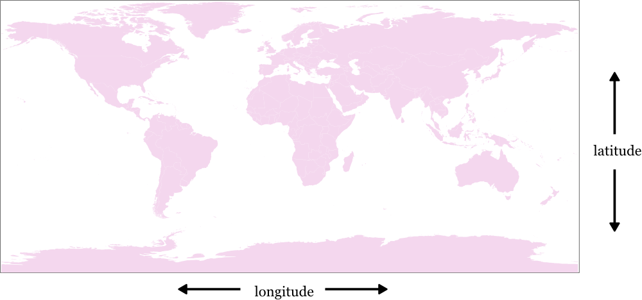
Locating Things on Earth
Latitude: -90 at South Pole, +90 at North Pole
Longitude: -180 to 180, 0 at prime Meridian

Slide 8
Geocoding
Geocoding
e.g. 1600 Pennsylvania Ave NW, Washington, DC → (Lat, Long)
(38.898662, -77.036380)
“What’s here?” on google map will give you lat long
Reverse Geocoding
(38.898662, -77.036380) → Whitehouse
APIs & Tools
http://open.mapquestapi.com/geocoding/
CartoDB

Slide 9
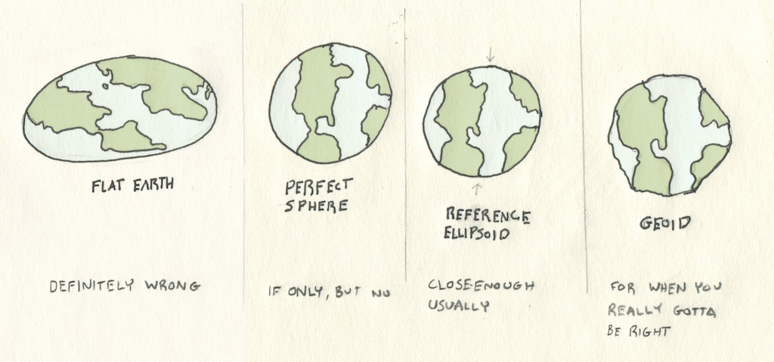
Earth is Not Round!
Notes:
Geocoding is all very practical, but in reality there’s a lot of fudging done to get from a non-perfect sphere of the earth to a flat projection of a map.

Slide 10
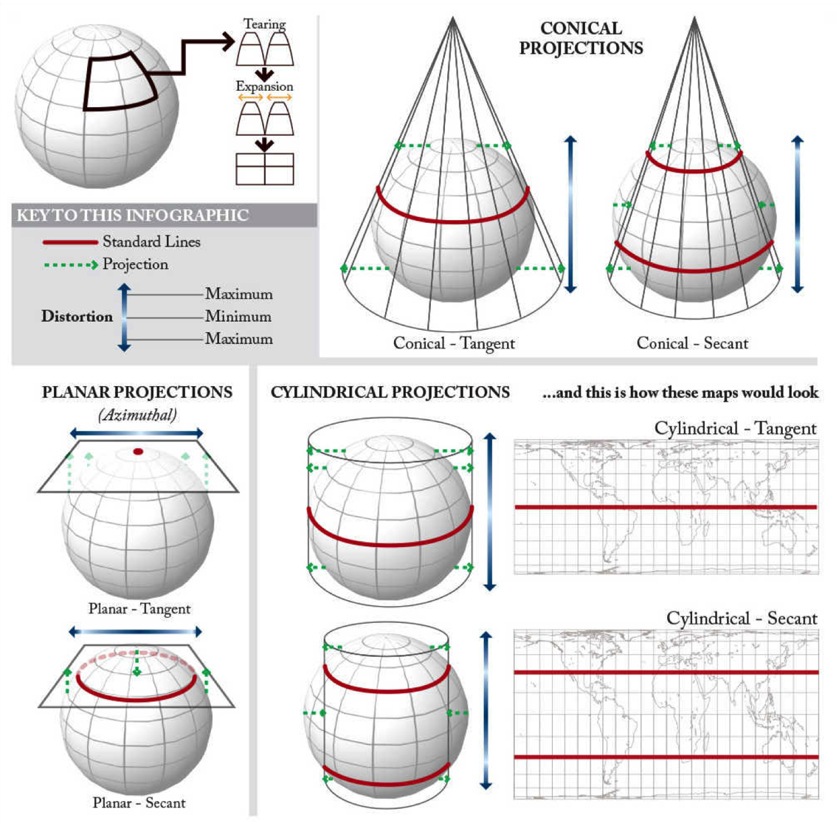
Projection
Notes:
Projection …
Need to get our pseudo-round object onto a flat surface. Projects are closest along standard lines so try to have one near where your story is if showing that area.
Three shapes that you can make into a flat map are a plane, a cone, and a cylinder. Those define different types of projections that distort reality in different ways.
There are five properties that will be distorted when you project a globe on a flat surface: shape, area, angles, distance, and direction.

Slide 11
“No flat map can match the globe in preserving areas, angles, gross shapes, distances, and directions, and any map projection if a compromise solution.”
-Monmonier

Slide 12
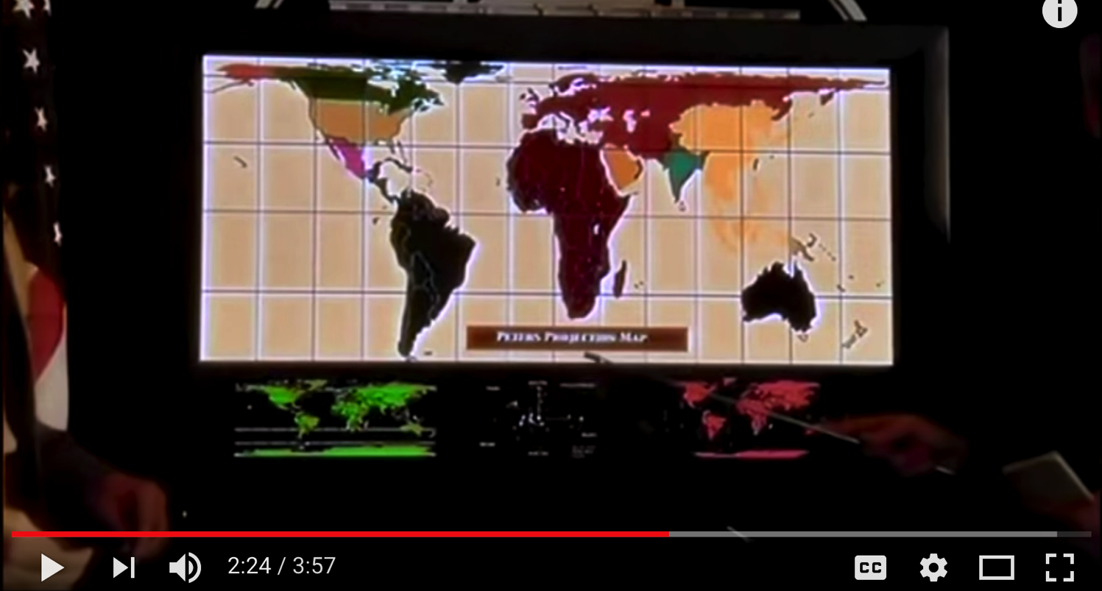
https://www.youtube.com/watch?v=eLqC3FNNOaI

Slide 13
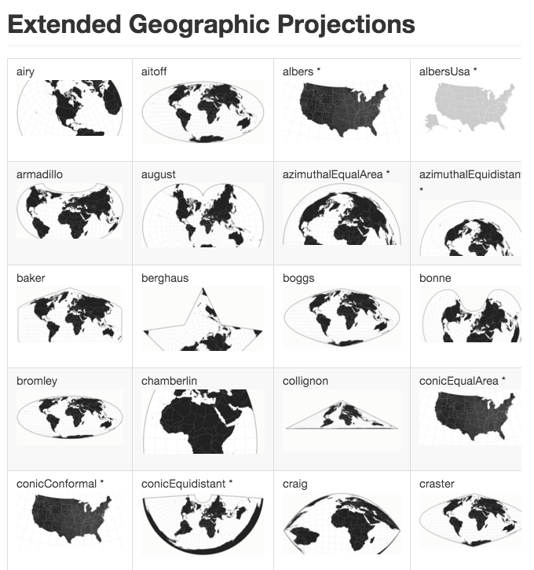
https://github.com/d3/d3-geo-projection/
Notes:
There are MANY projections … some are useful for different tasks, others are adapted for mapping information in a particular area of the world (i.e. Their standard lines or where they’re attached to the globe)
Albers is often used for area mapping in the US. It’s a conic projection. Azimuthal is good for polar regions. In the Cairo reading from this week there’s a good guide to choosing for some common applications.

Slide 14
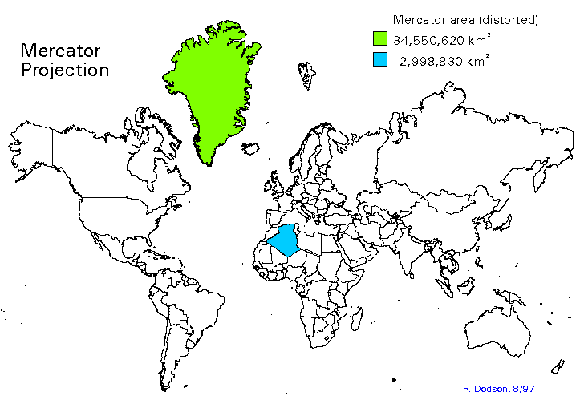
Notes:
Although useful for navigation, the mercator projection distorts areas substantially.
Algeria is actually bigger than greenland in actual terms

Slide 15
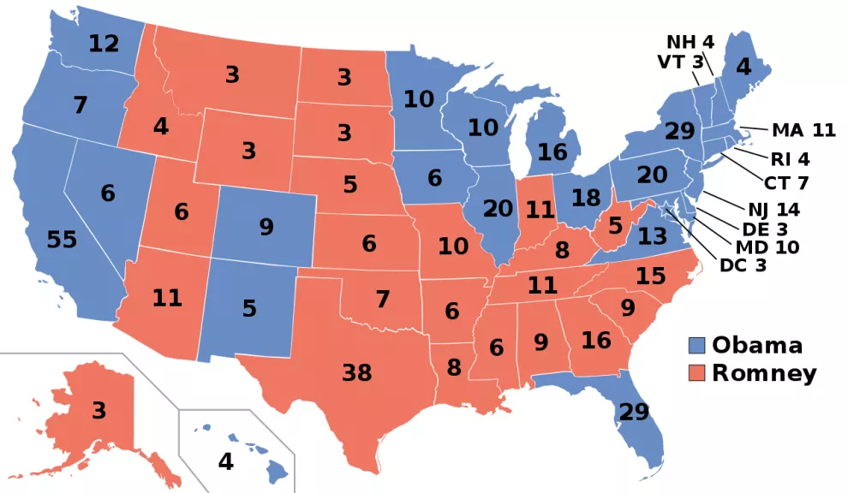
What’s this map good / bad for?
Notes:
Distortion is not just about projection method, but also mapping used (e.g. area mapping in this example)
This map shows the outcome per state. But because some states are not dense e.g. Montana but don’t have many electoral votes it can be misleading if you’re trying to see who won from the map. So sparsly populated areas look more prominent.
What is this map actually good for then? Seeing regional distribution, or as a lookup so people can easily find a state and see how it voted.

Slide 16
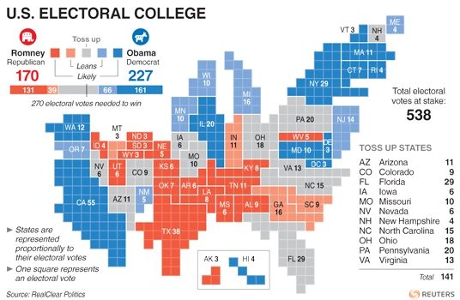
Cartograms
Notes:
Cartograms distort area and space entirely in the interest of showing something else entirely … in this case they are proportional to electoral votes.

Slide 17
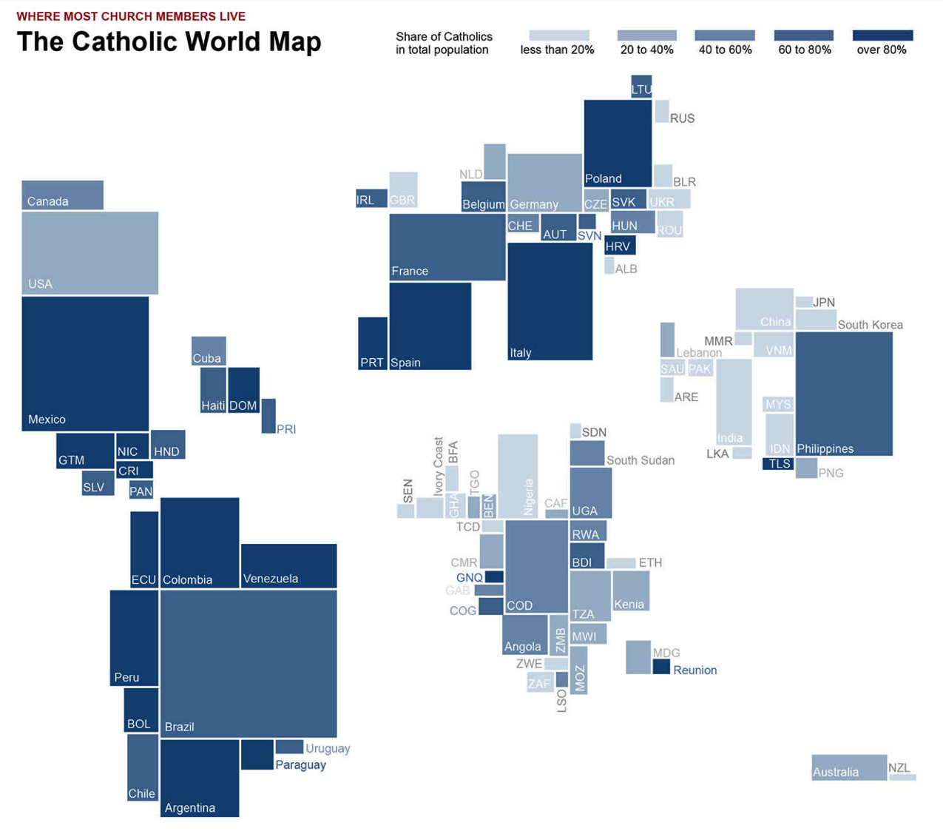
Notes:
Another example of a cartogram, should total number of catholics as size of rectangle, and proportion of catholics as shade.

Slide 18
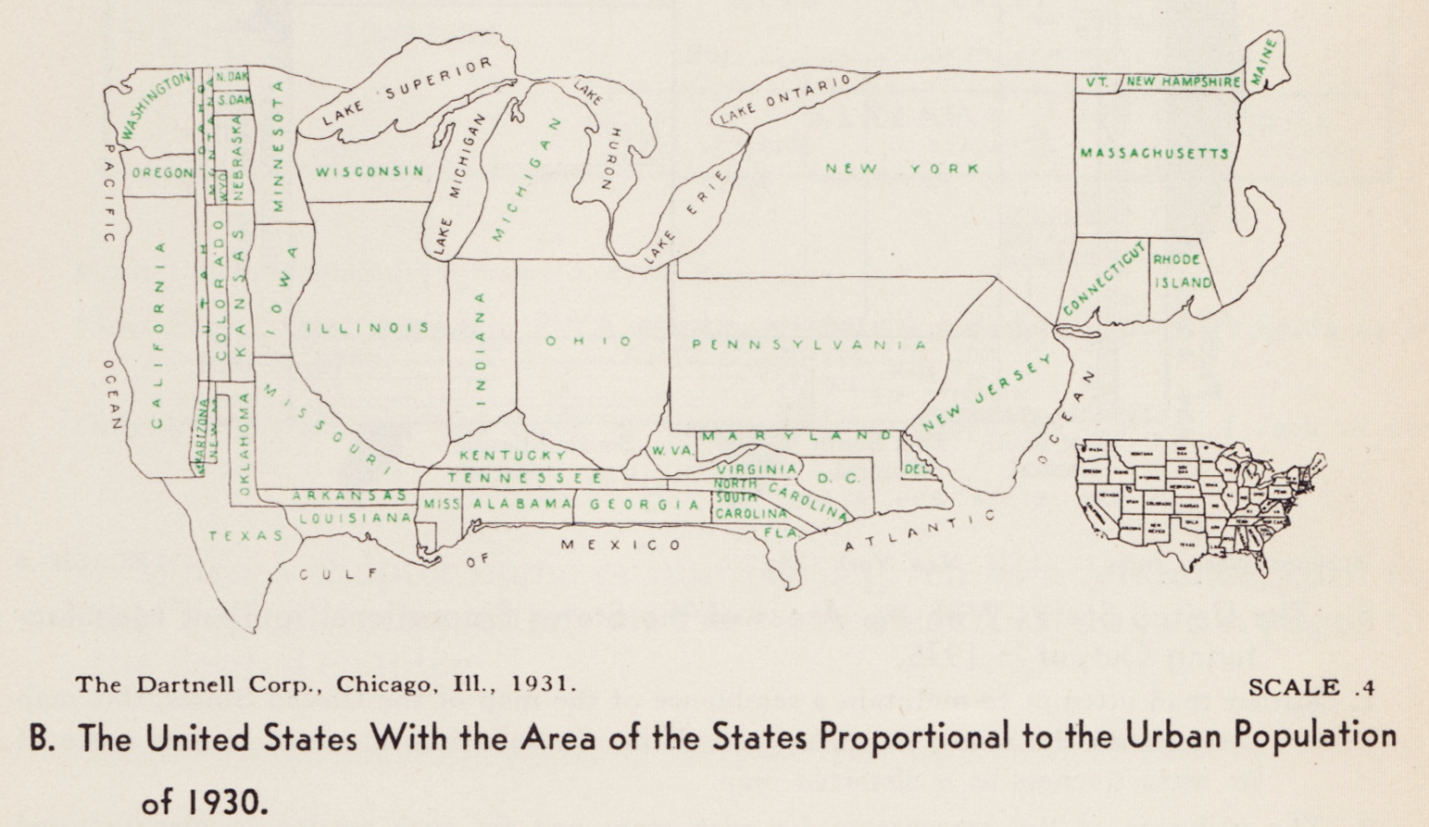
Notes:
Not a new idea, the cartogram. Here’s an example from 1931 that distorts area with population

Slide 19
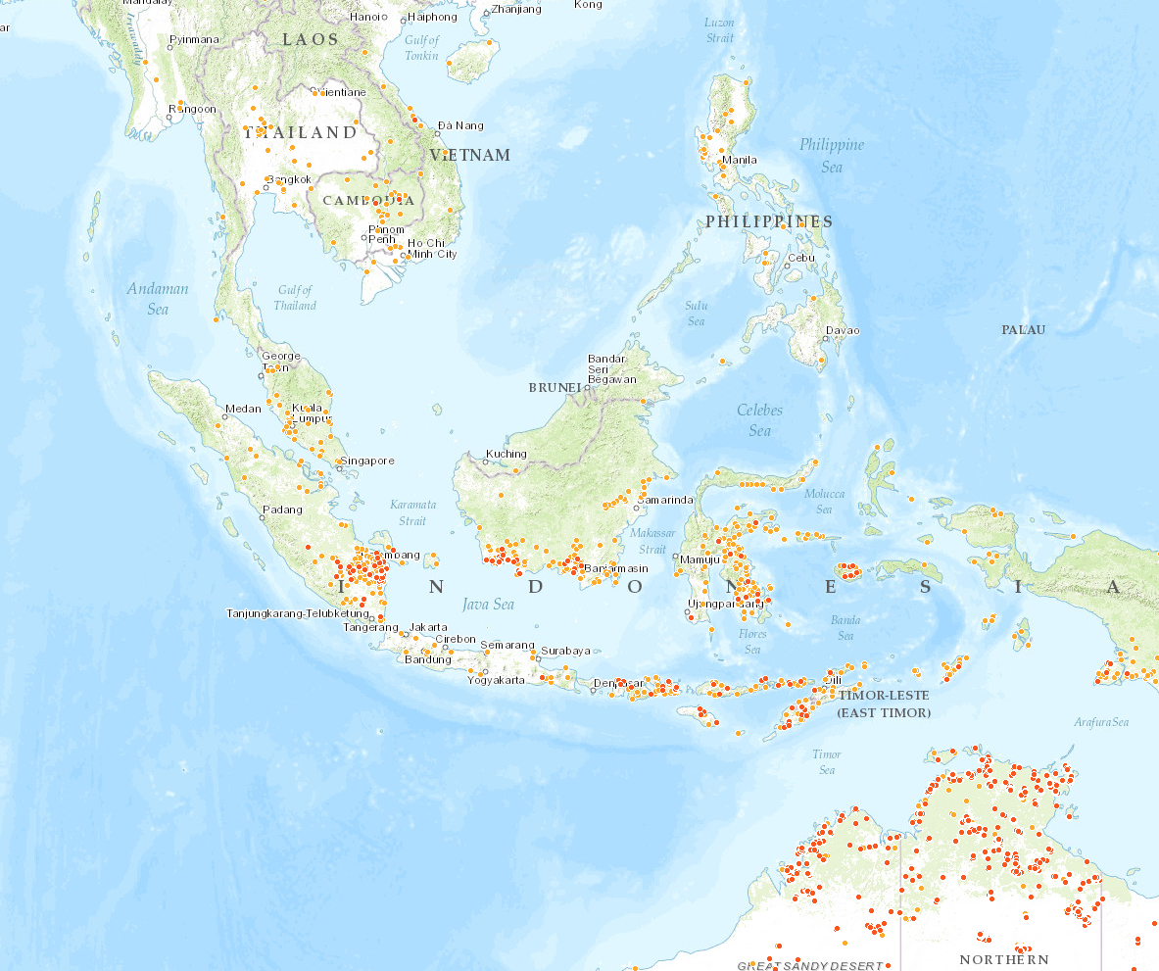
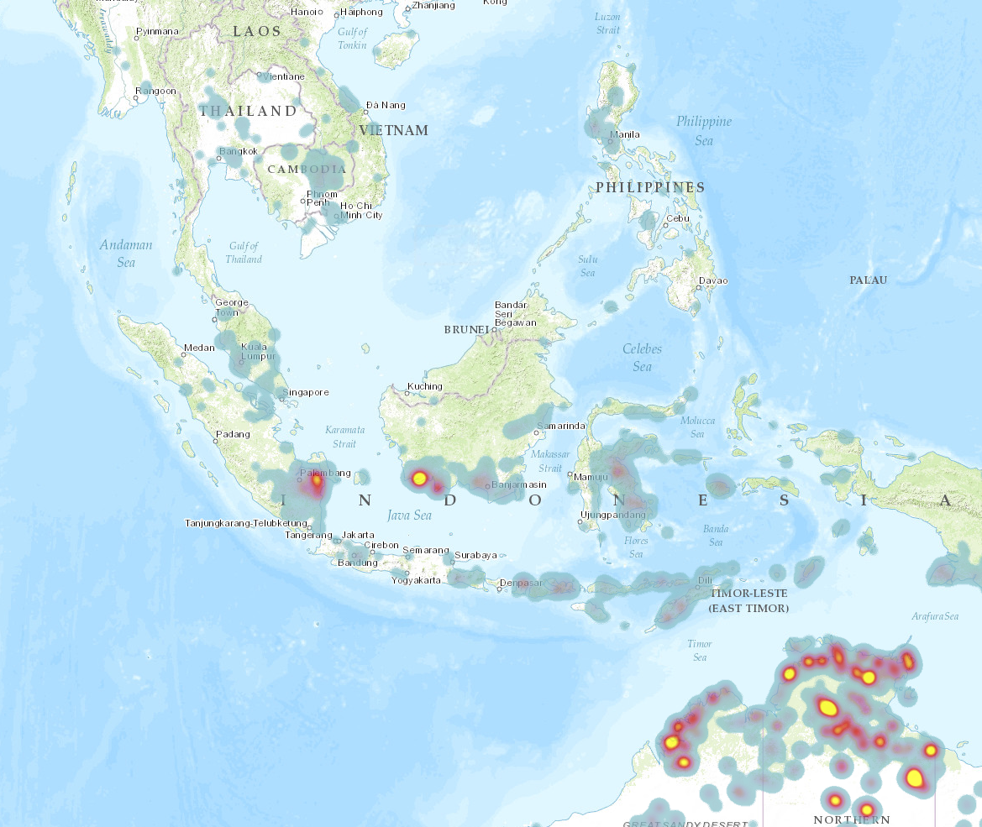
http://fires.globalforestwatch.org/
Notes:
Symbol or dot map useful for showing individual data point and letting people drill into those.
Or a heat map which is showing density of events which can be useful for aggregating and seeing overall geographic patterns. These are called isarithmic maps or contour maps and they are drawn by connecting areas of equal value.
Incidentally this map made with some other powerful mapping software that is sometimes used from ESRI.

Slide 20
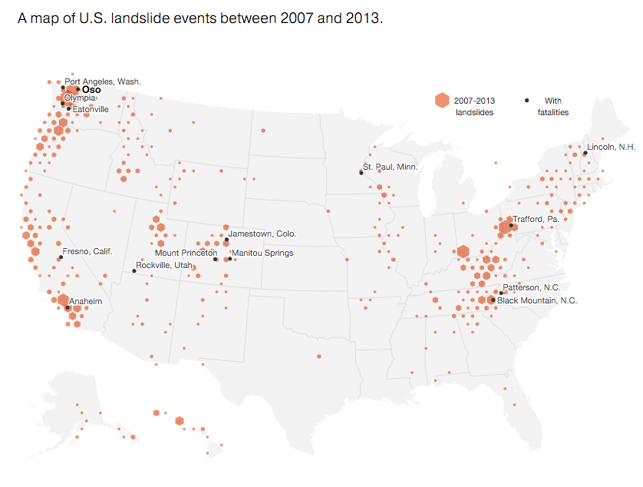
Notes:
Hexagonal binning can be useful to show densities as well (instead of heat map). Either way, the issue with occlusion and estimating densities of individual points on a map can be a alleviated like this.

Slide 21
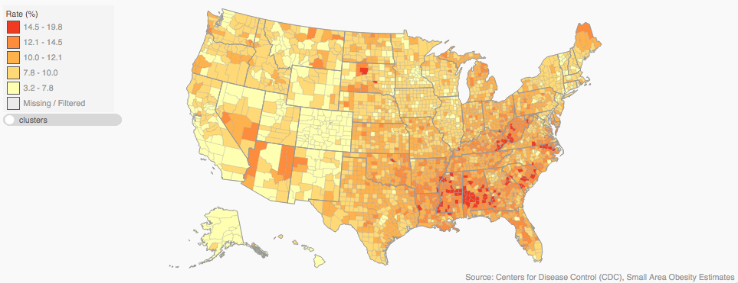
Choropleth
Notes:
Choropleth maps are another way to aggregate data. They map data to areas. The problem with choropleths is that the area of a geographic unit might be bigger but that doesn’t mean that it’s more important or that the color from that area should be more dominant. E.g. in this example large counties in arizona take up a lot of space but are much more sparsely populated than counties in NY or IL.

Slide 22
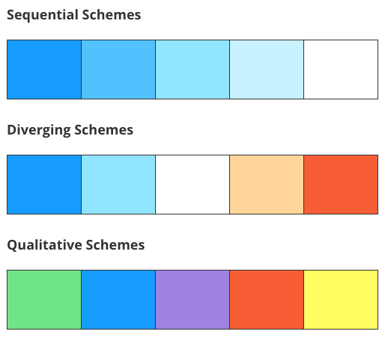
Colors for Maps
http://geojournalism.org/2014/06/tips-for-using-color-in-maps/
Notes:
Sequential for mapping quantitative data.
Divergent are good for highlighting areas that significantly diverge from the norm. Try to pick more saturated colors for extremes
Qualitative is for qual data. You can use saturation to control attention an highlight.

Slide 23
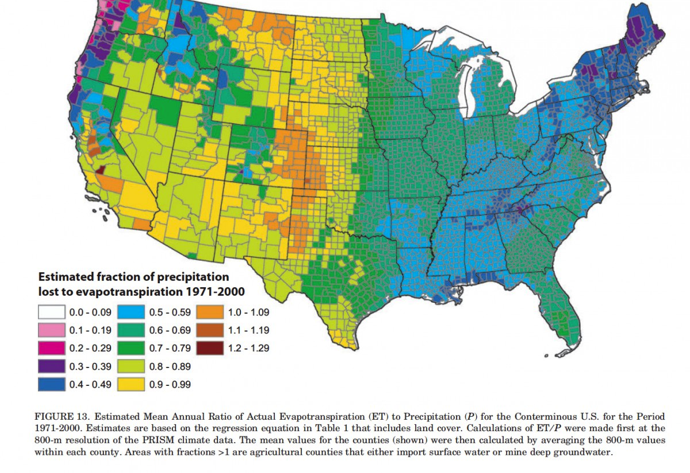
https://eagereyes.org/basics/rainbow-color-map
Notes:
Quick, what’s the problem with the colors on this map?
Criticism of rainbow color gradients is that there’s no natural perceived order to their colors
Sharp jumps in hue, and differences in intensity make it hard to understand this map as a continuous ramp b/t 0 and 1.29.

Slide 24
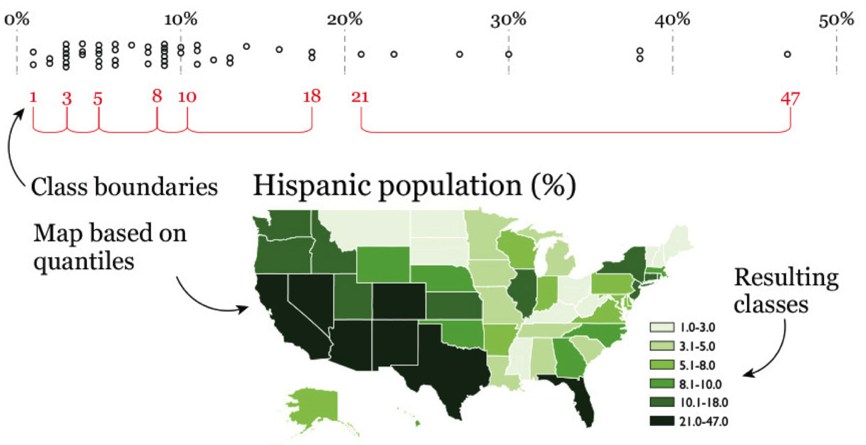
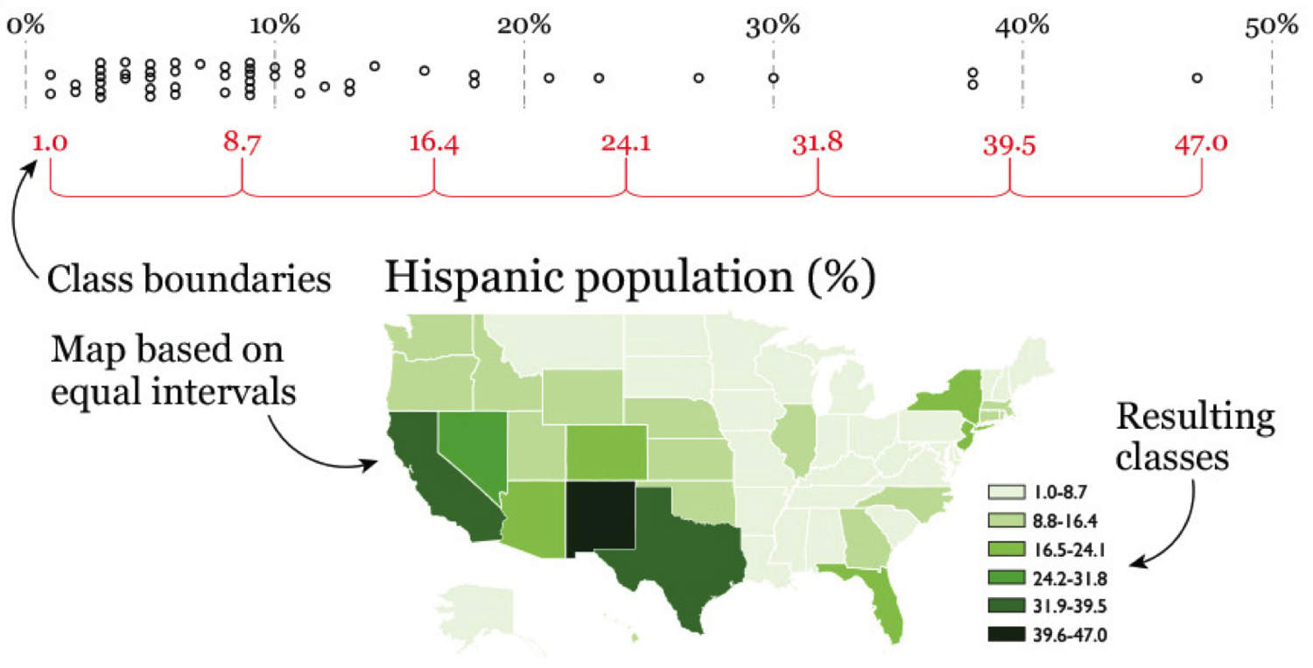
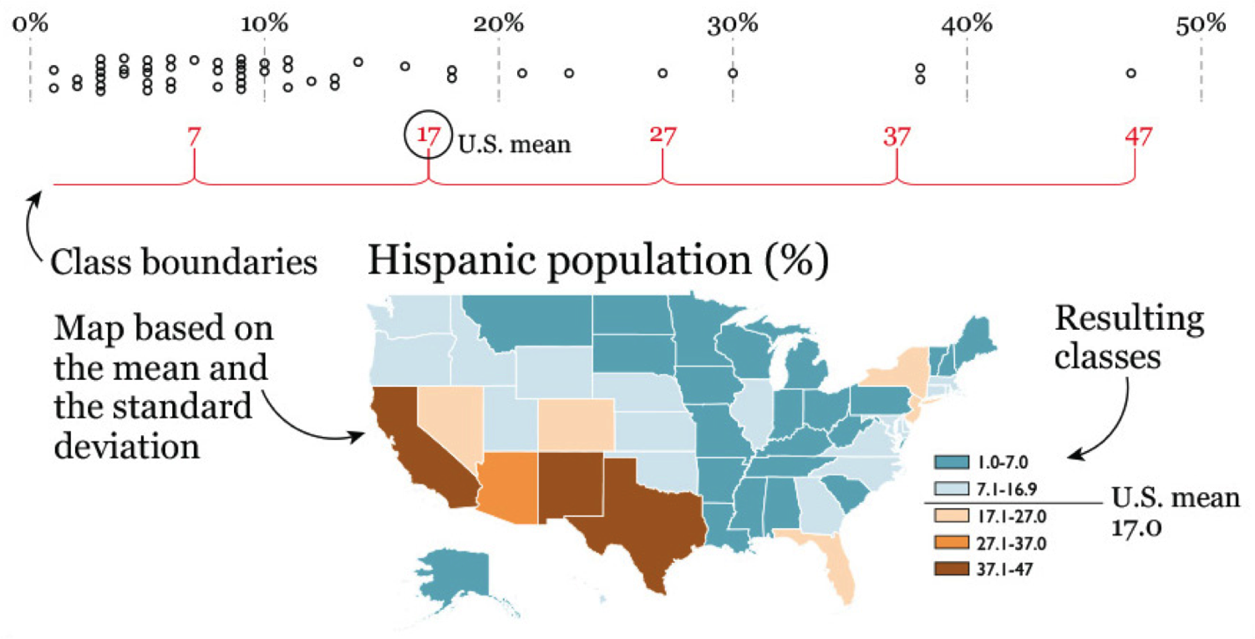
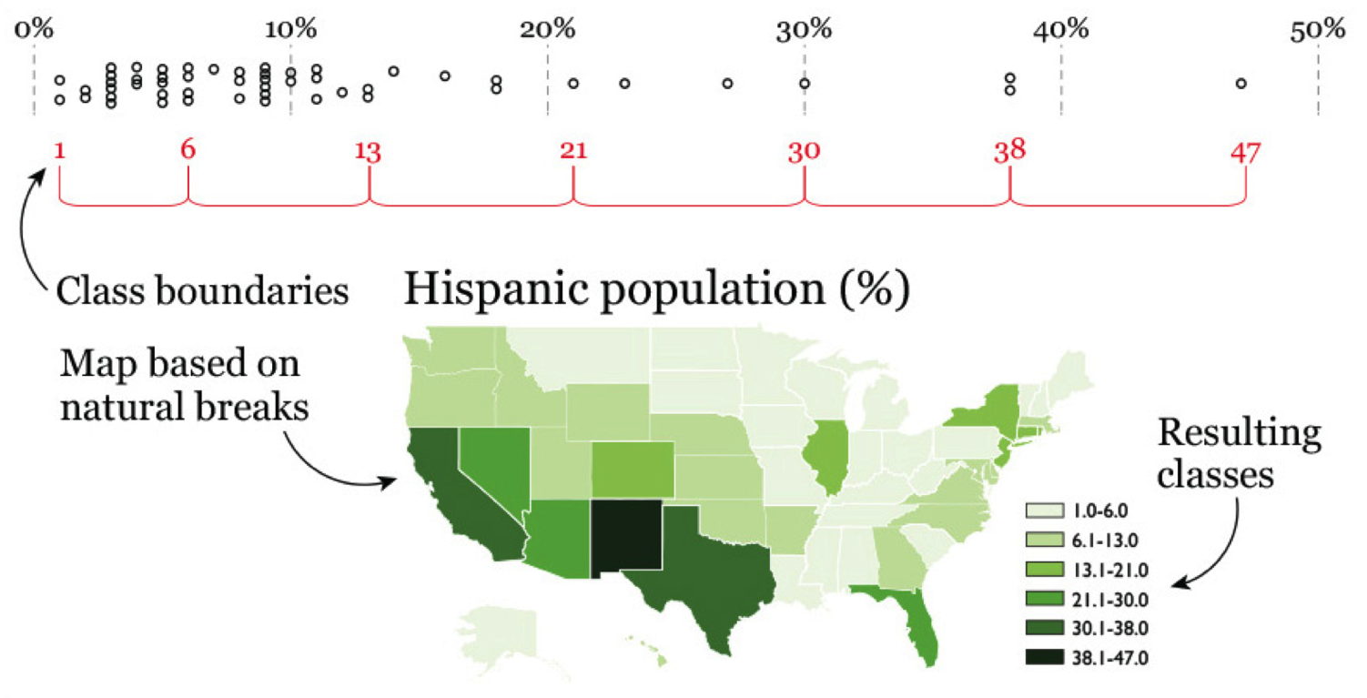
Choosing Intervals
Notes:
The other thing you need to be aware of for choropleth maps is choosing your intervals. You can use different techniques for doing this but it can change the story and what you see from the map based on how you choose those intervals.
You can do equal size intervals, quantiles (helpful for seeing detail in skewed distributions), or use the mean / median and standard deviation (for diverging). And there are algorithms like the Fisher-Jenks that try to optimize the bins based on statistical properties of the distribution.

Slide 25
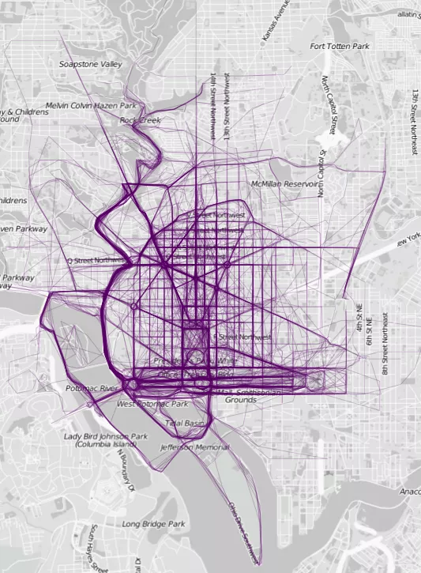
http://flowingdata.com/2014/02/05/where-people-run
Notes:
Visualizing running paths on a map. Using the “line” primative instead of points or areas. Can give you a sense of use and density of paths.

Slide 26
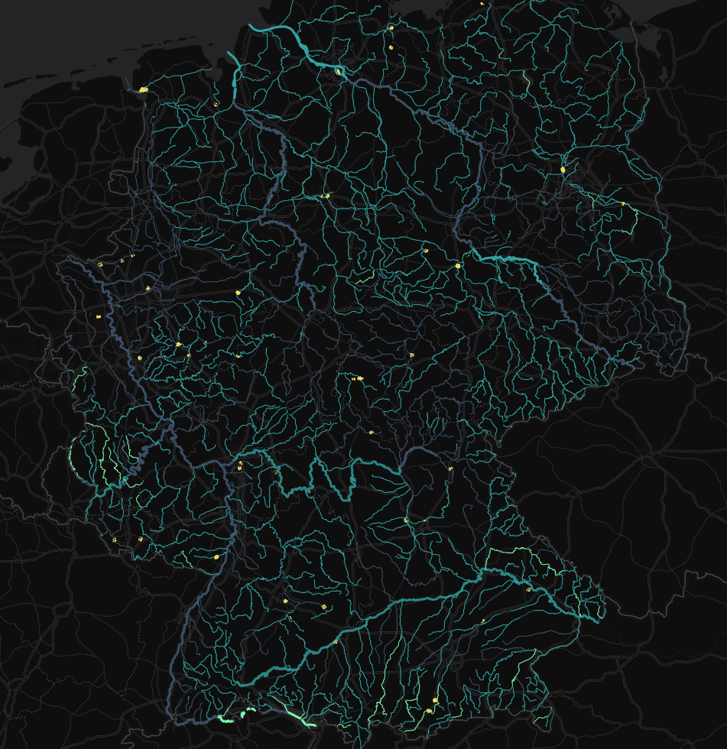
http://infovis.fh-potsdam.de/mappingzebras/waterquality/
Notes:
And you can combine types to show correlations and tell stories. The brighter the color of the river the better the quality. Industry is yellow.

Slide 27
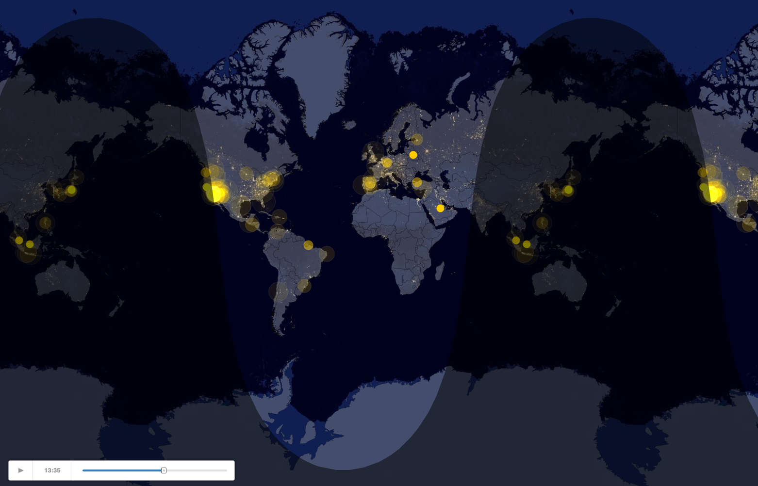
http://cartodb.s3.amazonaws.com/static_vizz/sunrise.html
Notes:
Animation on maps can lead to some interesting opportunities for storytelling. In this example people mentioning “sunrise” in a tweet.

Slide 28
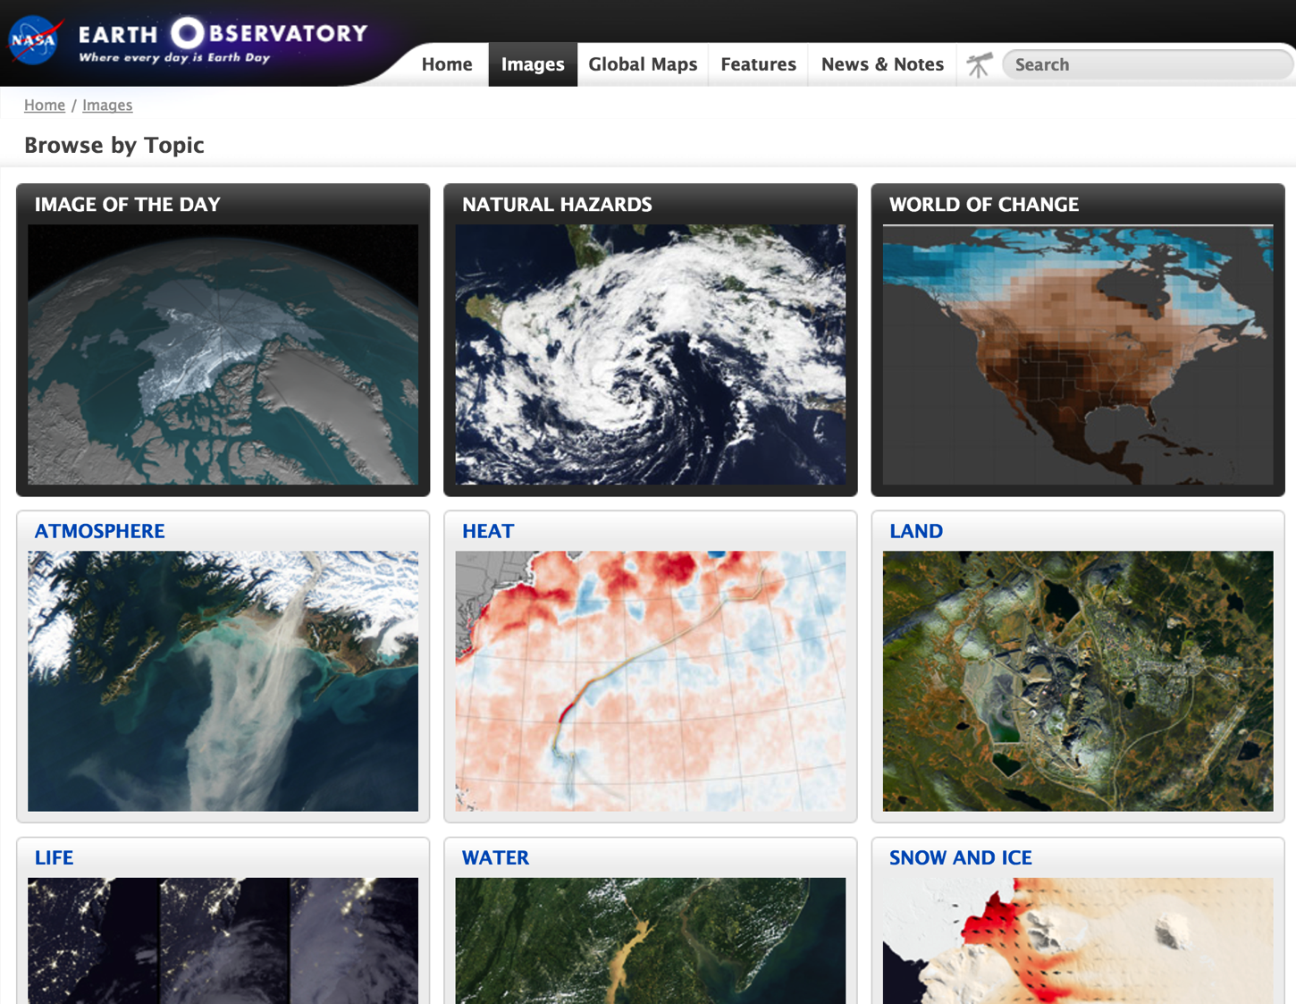
Notes:
And I’ll leave you with some MapZen. NASA’s earth observatory has some amazing imagery for all kinds of different things.

Slide 29
Questions?

